Slide 1
Public Relations
2025-2026

Slide 2
Goals from 2025
Address our poor social media presence.
Resuscitate our neglected platforms.
Build working relationships with other affiliates.
Get the NJLP into the news.
Develop working relationships with other affiliates.
Help establish the NJLP as a voice in the Liberty Movement.

Slide 3
The Strategy to Fix It
Create a consistent weekday posting schedule.
Ensure a consistent voicing and approach to posts and replies.
Deal with, rather than ignore harassers, scams, bots, etc.
  Leaving them alone just lets them propagate.
    Rarely, that does require banning accounts.
Ensure that all posts were inline with Libertarian philosophy and our State and National Platforms.

Slide 4
Posting Schedule
  Meme Monday (Made by me rather that reposting others’ work).
  Teaching Tuesday ( Quotes and links to Libertarian philosophy).
  What’s Happening Wednesday (Weekly schedule updates).
  Thoughtful Thursday (Updates and appreciation posts by and about members).
  Follower Friday (User engagement questions).

Slide 5
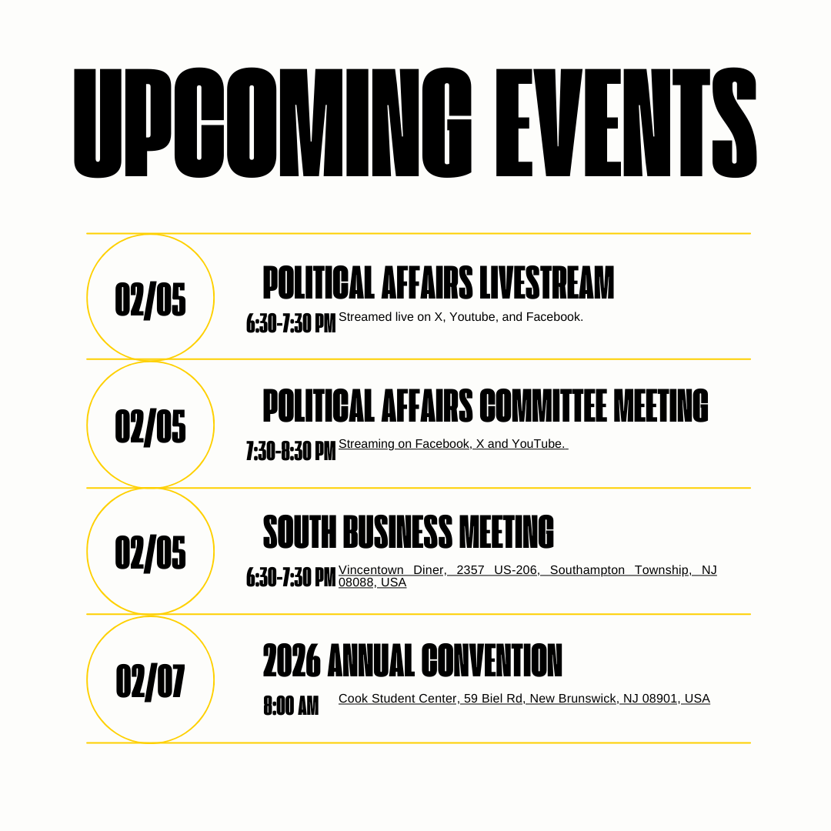
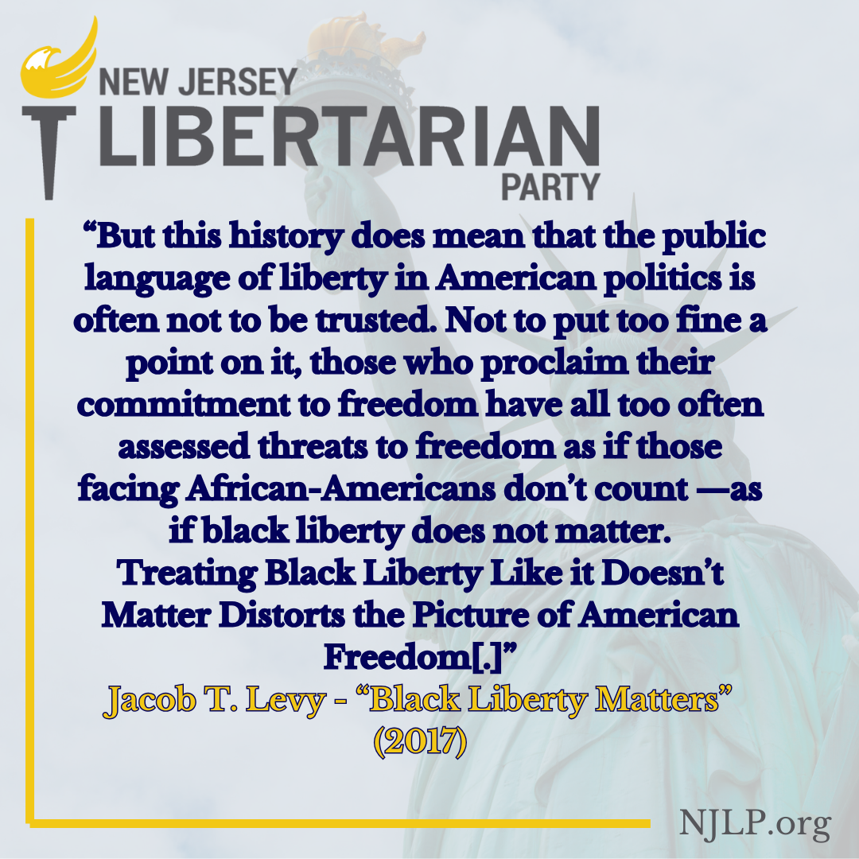
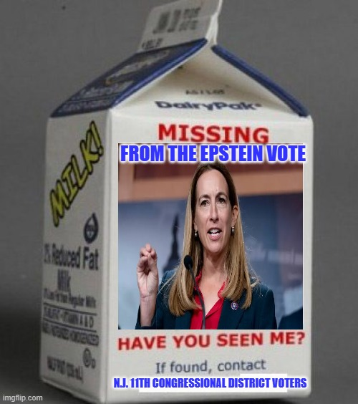

Slide 6
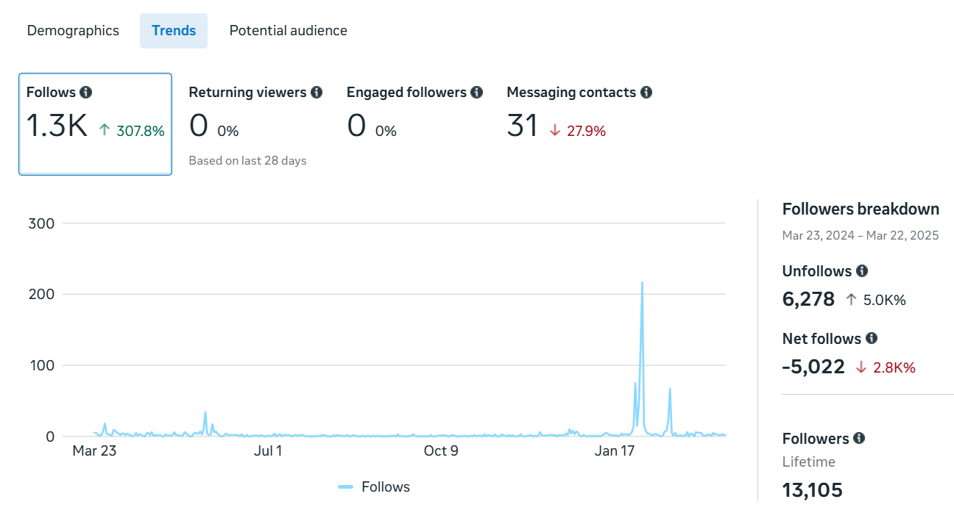
Facebook
Off-brand messaging.
Massive follower drop.
Repost-farming.
Bot-riddled.
Hostile.

Slide 7
Metadata Comparison: Facebook
24-25 (3-03-25/ 03-22-25) 384 Days:
Views: NA
3-Second Views: 303
1-Minute Views: 6
Content Interactions: 113.9K
Watch Time: 1h29m
Visit Totals: NA
From Organic: NA
Follows: 1.3K
Unfollows: 6,284
Net Follows:-5,002
25-26 (3-22-25/ 02-01-2026) 316 Days:
Views: 1.2M
3-Second Views: 11.9K (Up 3.8K%)
1-Minute Views: 398 (Up 6.5K%)
Content Interactions: 34.5K (Down 66.1K%)
Watch Time: 3d16h (Up 5.8K%)
Visit Totals: 1,173,610
From Organic: 1,173,610
Follows: 945 (Down 15.2%)
Unfollows: 1,258 (Down 79.7%)
Net Follows:-313 (Up 93.8%)

Slide 8
X (Twitter)
The page was largely just a repost farm without original content or meaningful engagement.
We hadn’t maintained communication with other affiliates.
Our reply rate was poor.
We weren’t actively promoting our candidates.

Slide 9
Metadata Comparison: X (Twitter)
24-25 (3-03-25/ 03-22-25) 384 Days:
Tweets: 382
Retweets: 759
Impressions: 173,226
Engagements: 4,127
Replies: 162
Clicks: 130
Likes: 2,660
New Followers: 76
25-26 (3-22-25/ 02-01-2026) 316 Days:
Tweets: 538 (Up 44%)
Retweets: 344 (Down 54%)
Impressions: 250,783 (Up 46%)
Engagements: 4,543 (Up 12%)
Replies: 444 (Up 178%)
Clicks: 679 (Up 453%)
Likes: 2,177 (Down 17%)
New Followers: 157 (Up 107%)

Slide 10
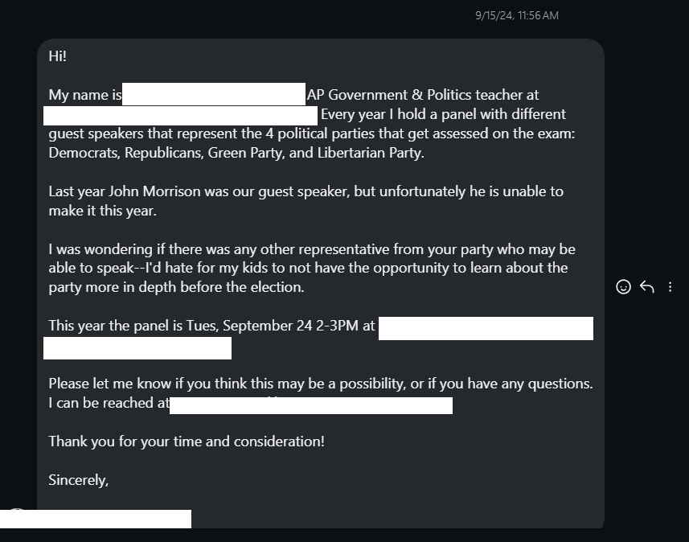
Instagram
Our last post before I took over was back in January 9th, 2024.
  The last Board posted nothing for an entire year.
No attempts were made to promote candidates.
We failed to reply to messages, including speaking opportunities.

Slide 11
Metadata Comparison: Instagram
03-23-2023/ 01-09-2024 (Last two Boards total activity)(731 Days):
Posts: 7
Likes: 306
  Posts with 10+ Likes: ( 7/7) =100%
Comments: 6
Shares: 21
Reposts: 0
Percentage of Total Posts on Instagram: (7/745) = 9.4%
03-22-2025/ 02-01-2026 (316 Days):
Posts: 250 (Up 3,471.43%)
Likes: 2,233 (Up 629.74%)
  Posts with 10+ Likes: (104/250)= 41.6% (Down 58.4%)
Comments: 339 (Including Replies) (Up 5,550%)
Shares: 468 (Up 2,128.57%)
Reposts: 37
Percentage of Total Posts on Instagram: (250/745) = 33.6%

Slide 12

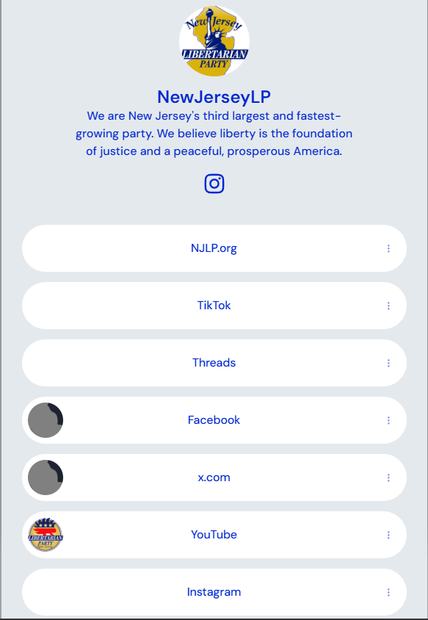

Social Media: Other
We started a Threads account that currently has 198 followers.
Lana opened up a TikTok account and created some videos for it.
We setup a linktree account and associated QR code for easy sharing.
We created two new spots:
  Debt Check (15th of the month).
  Dr. G’s Freedom Clinic (24th of the month).

Slide 13
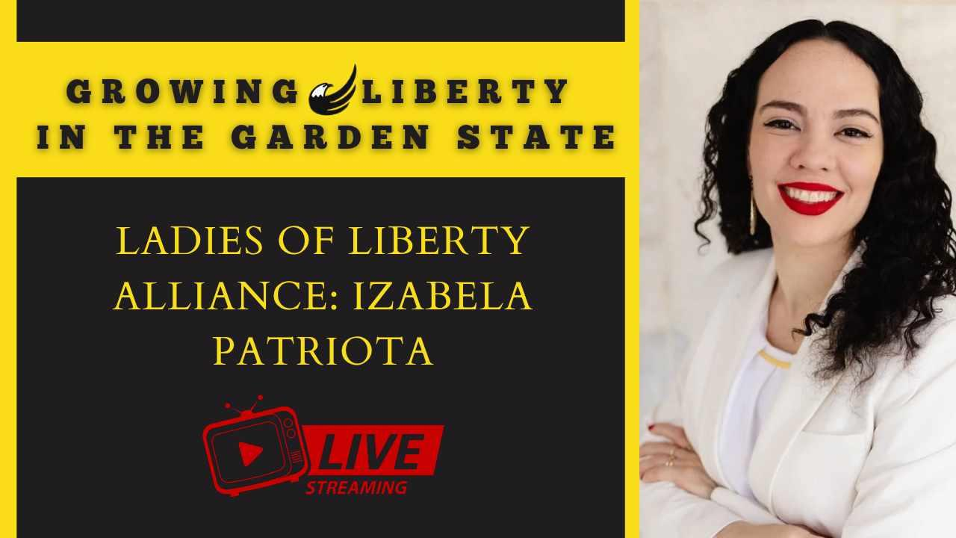
Growing Liberty in the Garden State
Lana and I set up a one-off interview show July 2nd with LOLA rep. Izabela Patriota.
We wanted to make it a regular program, but we need dedicated team members and a host.
We can’t have it be another Board responsibility.

Slide 14
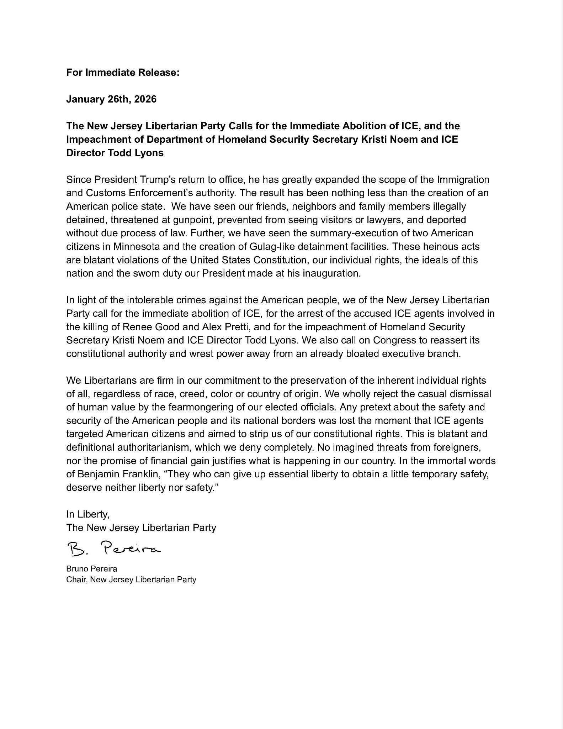
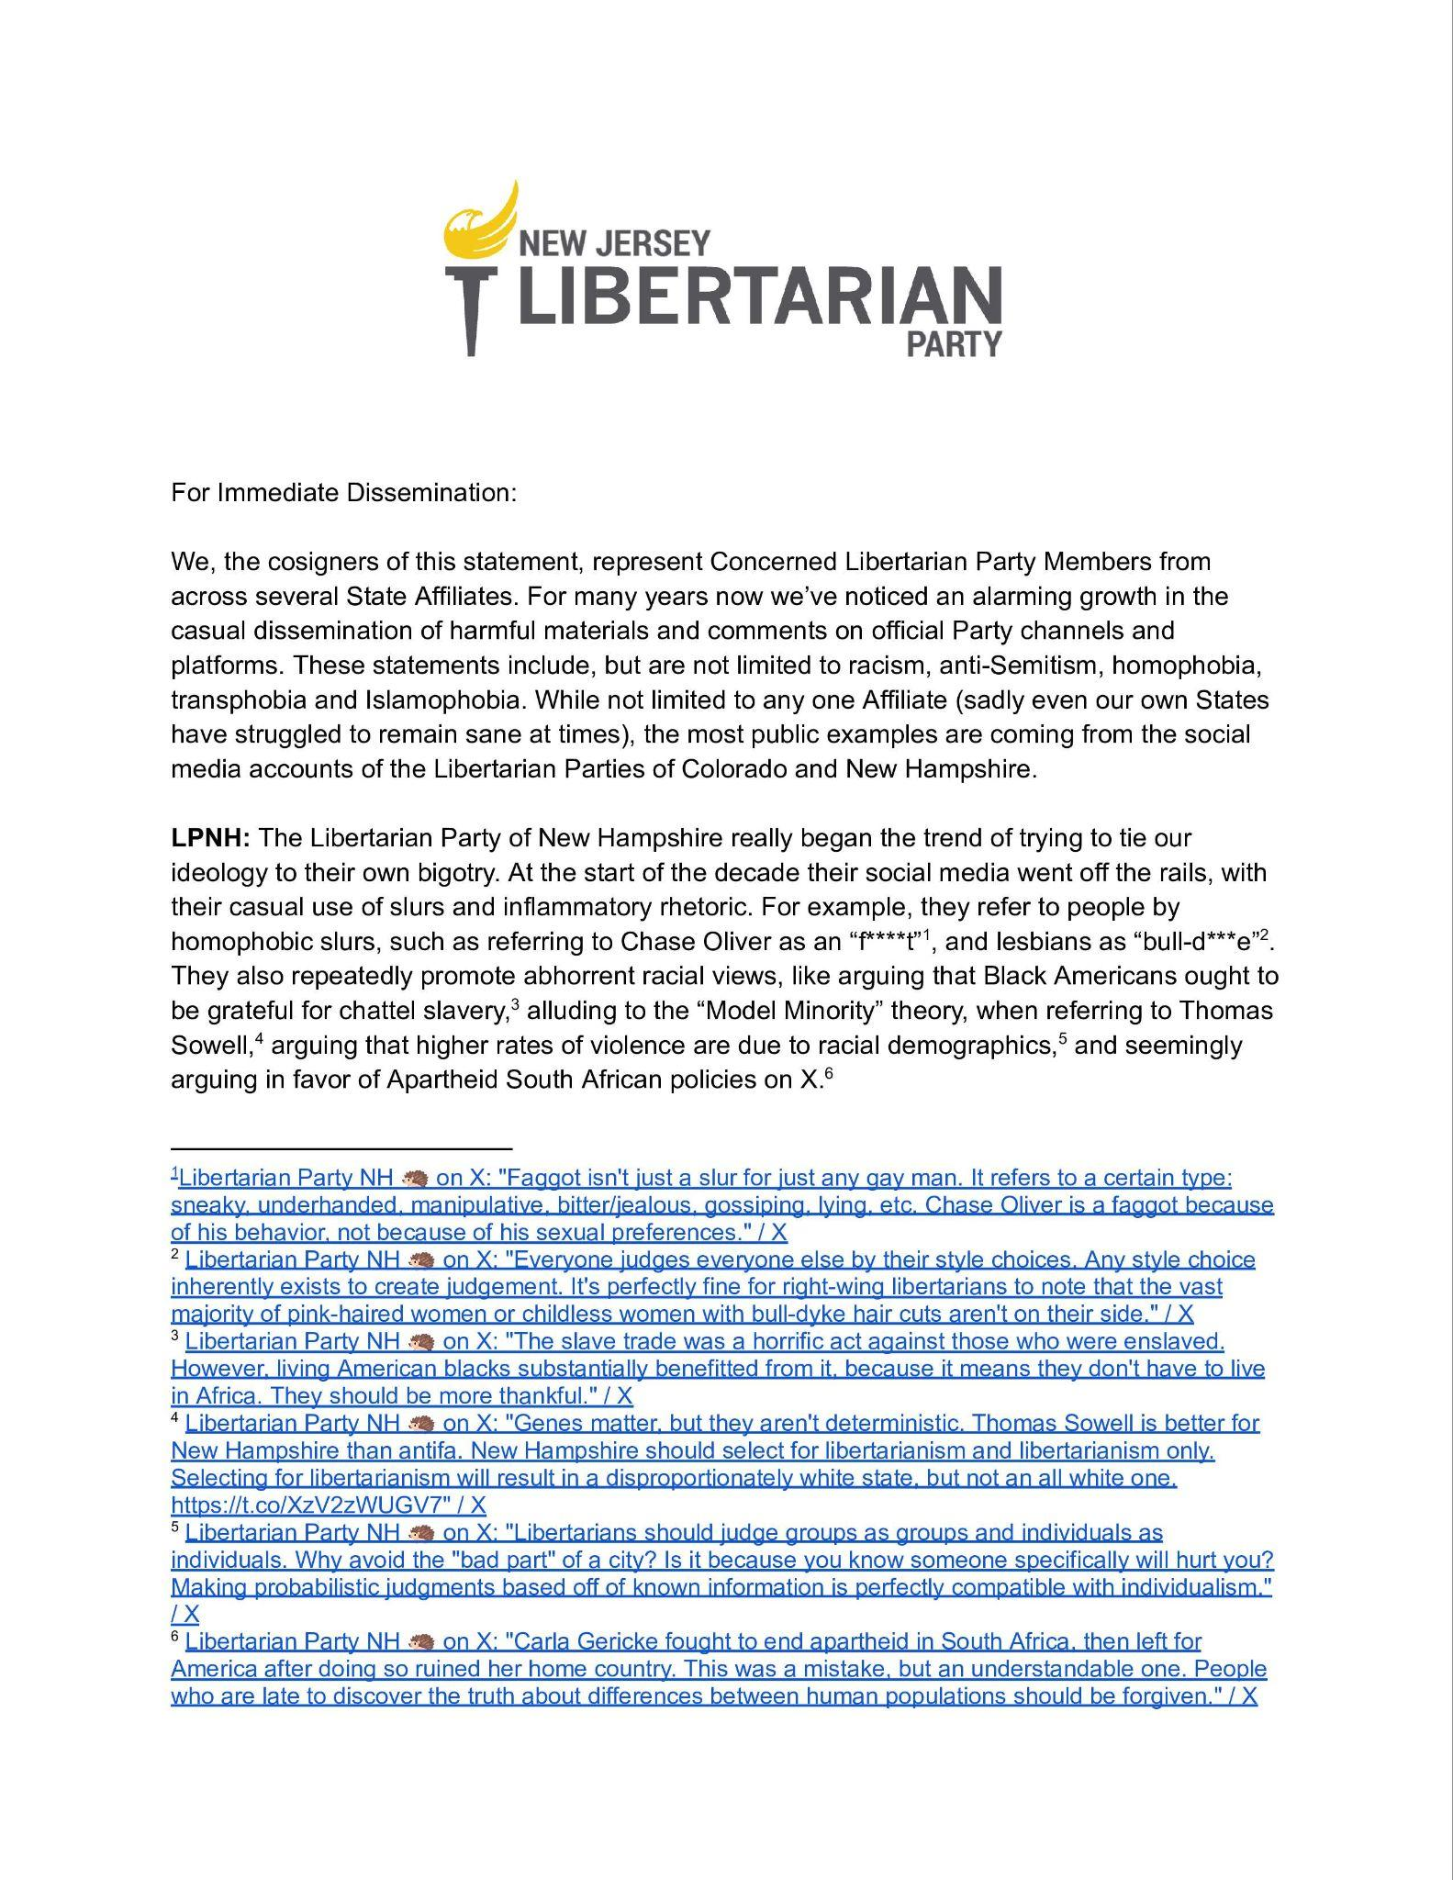
Party Statements
(April):
  Analysis of Trump’s First 90 Days.
    Statement by Bruno Pereira .
(May):
  Party Messaging Statement.
    Denouncement of LPNH and LPCO.
(July):
  Digital Privacy and Freedom Support.
    In partnership with LPTN.
(September):
  Free Speech Defence.
    Charlie Kirk Response.
  Epstein Declassification Support.
  Mikie Sherrill Privacy Response.
(November):
  Post-Election Concession.
  Condemnation of Iranian Bombing.
(January):
  Party Condemnation of Venezuela Invasion.
    Statement from Bruno Pereira.
  Abolition of ICE.

Slide 15
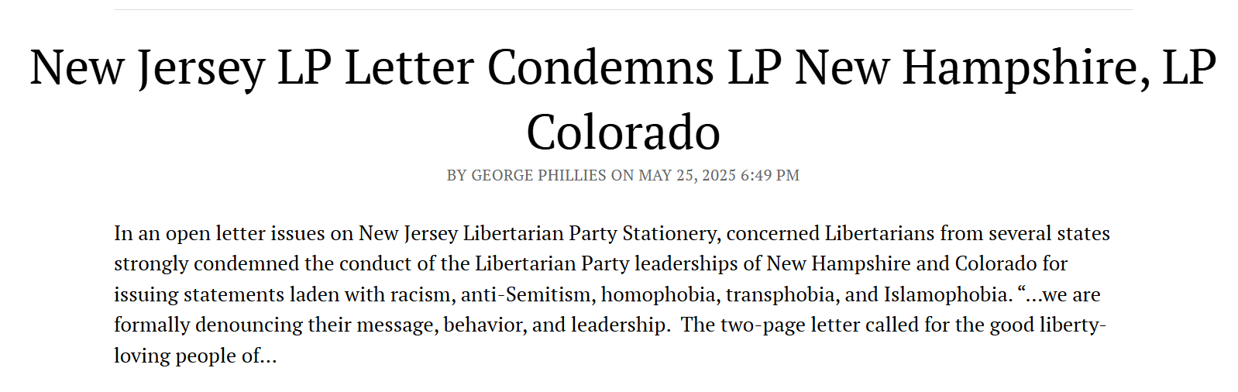
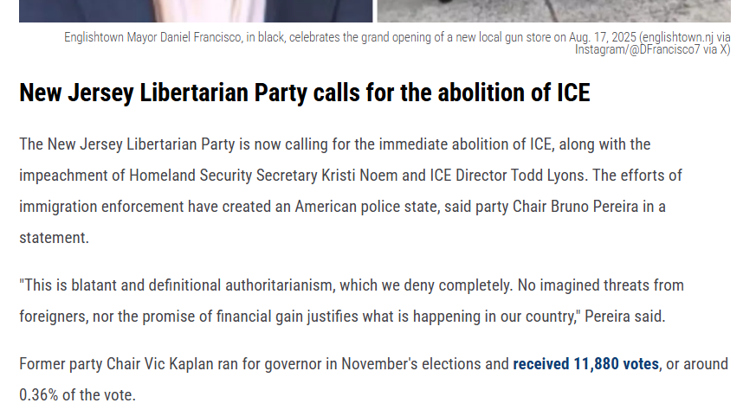
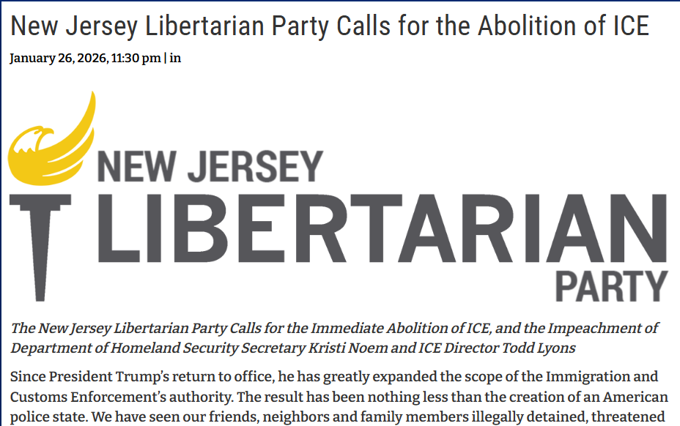
Media Responses
We don’t have many dependable ways to contact the press, but our statements did make the rounds through social media and were picked up.
(5-23): Third Party Watch reported on the New Hampshire/ Colorado statement.
  The comments section featured Libertarians from the aforementioned States that agreed with out assessment.
(1-26/ 28): Our ICE statement was reported on by Insider NJ and NJ 101.5.
  We were the only political Party referenced in the 101.5 article.

Slide 16
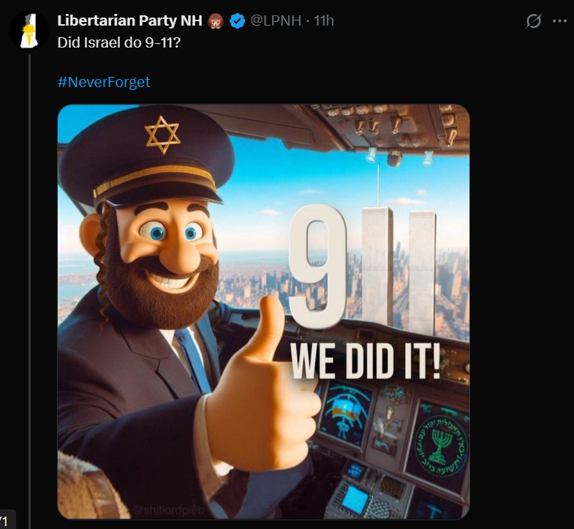
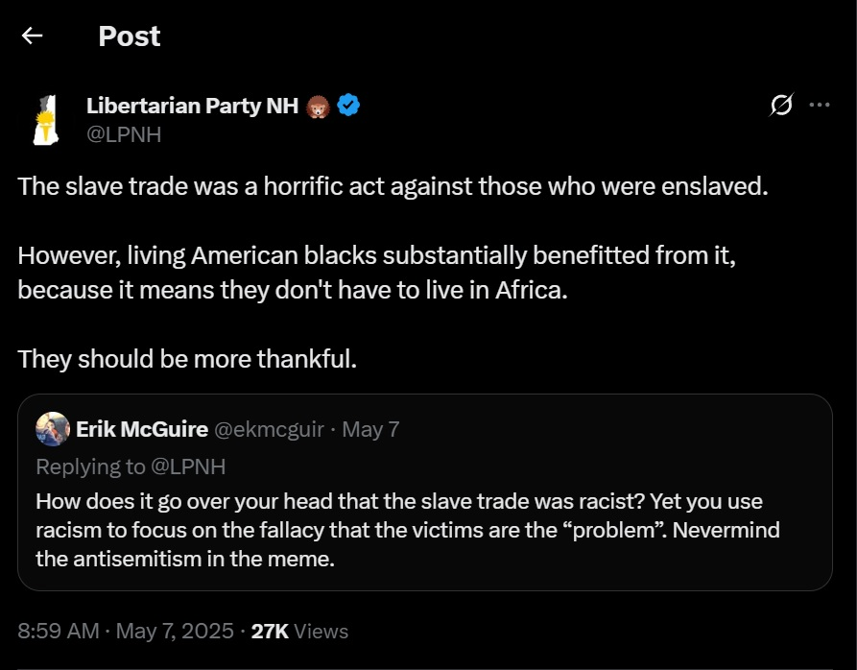
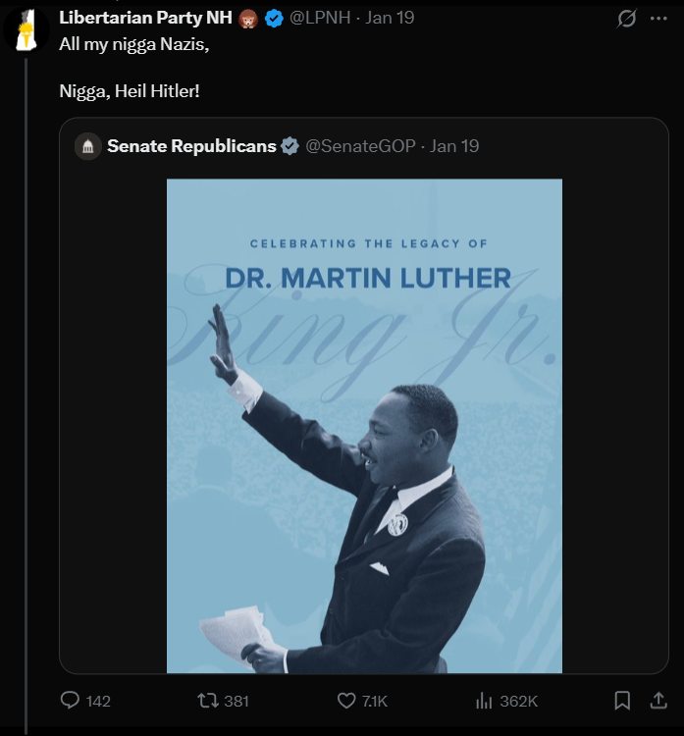
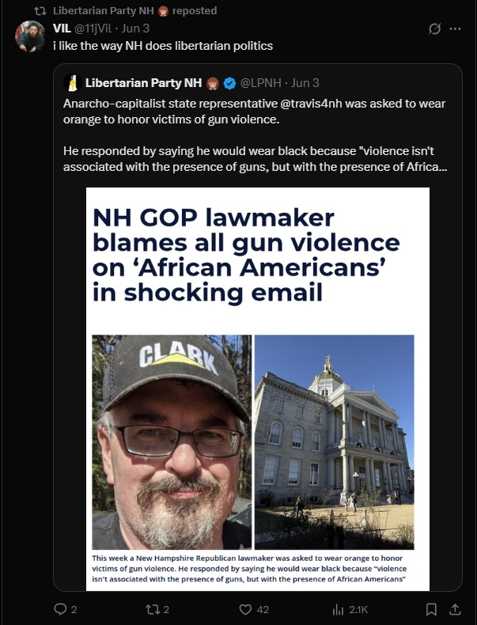
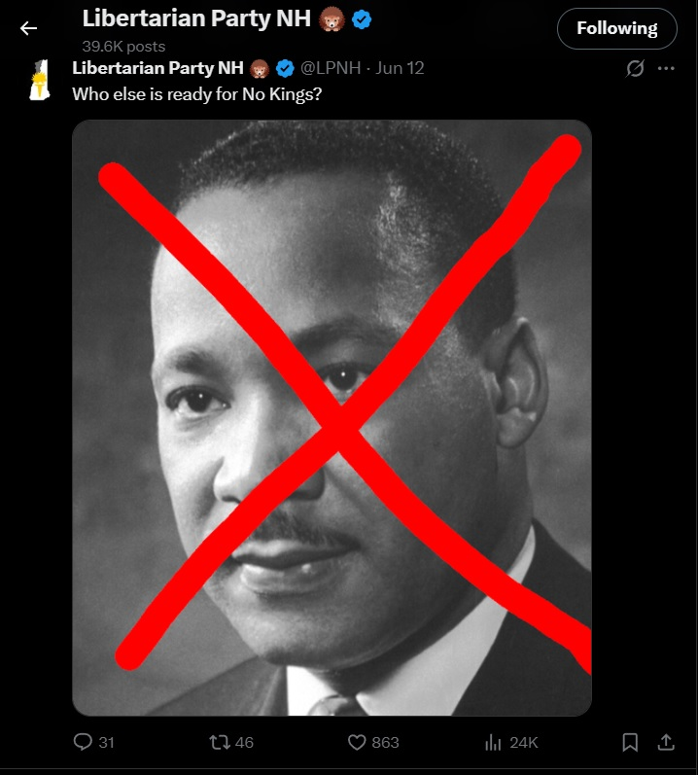
State of New Hampshire
The Board voted 7-2 to denounce LPNH and LPCO’s behavior.
  Received 240 likes and 49k views on X.
They lied about stopping this behavior several times.
Their continued messaging is hurting our efforts and those of other affiliates.
  They have about ⅕ of the followers as National.

Slide 17
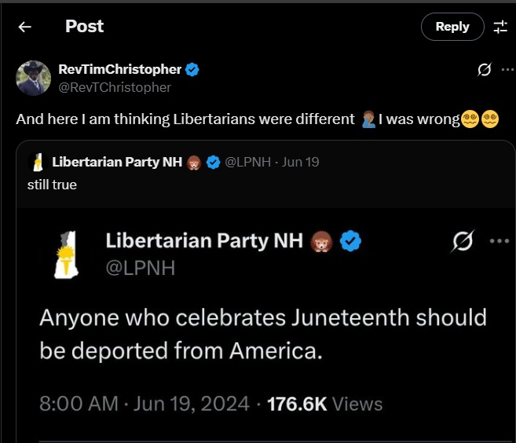
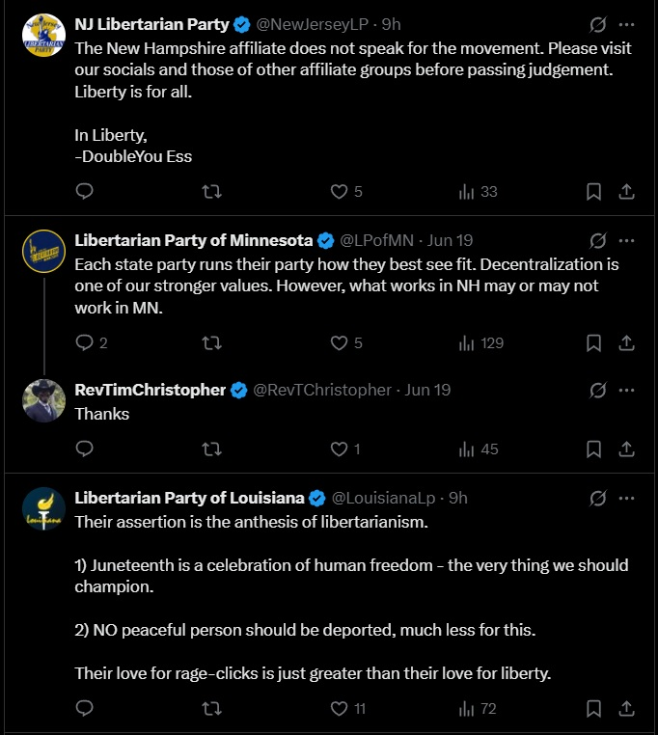
This Rhetoric is Hurting Us

Slide 18
What We Need Moving Forward
Social Media Changes:
Dedicated moderators/ content contributors for EACH platform.
  This is not a one person job (or at least it shouldn’t be).
Video creators for each Region to contribute to Tik Tok and Youtube.
Clear posting guidelines for both members and the comments section.
Formalized Party moderation authority over all affiliate Social Media.
Greater member engagement.
  Follow, Like, Comment, and Shares.
Rule/ Organizational Changes:
A dedicated budget and/ or bank account.
  We can’t afford anything.
Change the business rule requiring initials at the end of each post.
  For safety’s sake I suggest the use of membership IDs instead.
Regular Party statements.
  Monthly or more, if possible.
A greater impact on National’s messaging.

Slide 19
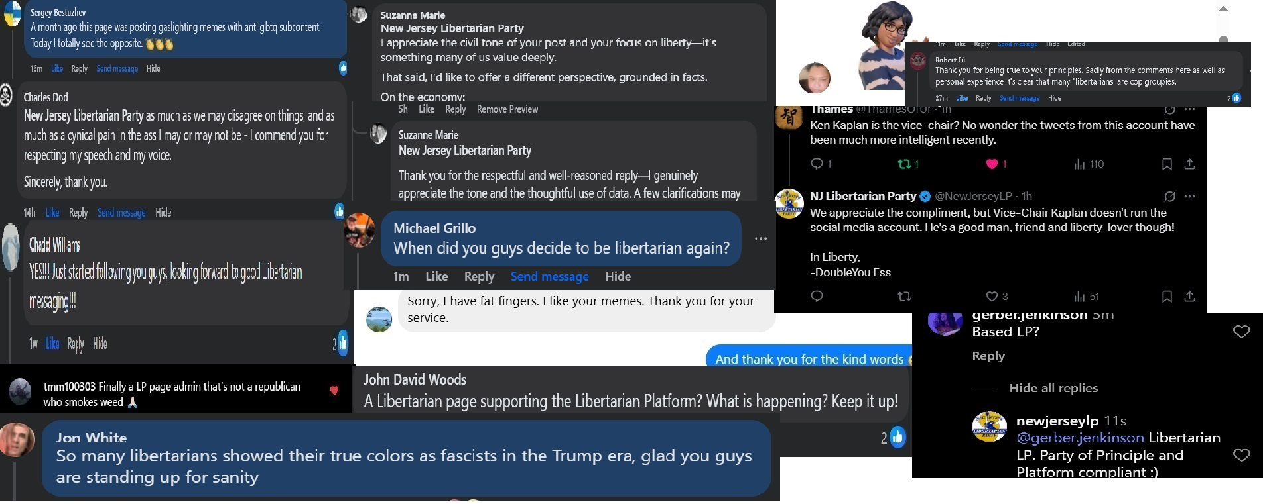
It’s Working

Slide 20
Special Thanks To
Lana Leguia:
  She made some art assets and helped with the video programming.
Jade Pao:
  Created the Wednesday post assets.
Jay Edgar:
  Moderation, engagement, website stuffs.
Dustin Maggard:
  Engagement farming.
Vic Kaplan Campaign:
  Generated great content.
Ken Kaplan:
  No Kings pictures were very popular.
Jim Tosone:
  His frequent posts made my job easier.
Louis Ciarlo:
  Amazon X (Twitter) hype man.
Mike Guadagnino:
  Wonderful writer.

Slide 21
Fin

